Slide 1




Faculty of Computing Universiti Teknologi Malaysia

Slide 2
CONTENT
01
HISTORY
02
CORPORATE INFORMATION
03
ACADEMIC PROGRAMMES
04
RESEARCH, DEVELOPMENT,
COMMERCIALIZATION & INNOVATION
05
ACHIEVEMENTS & HIGHLIGTS

Slide 3
HISTORY

Slide 4

HISTORY
Significant numbers of new academic programmes, CoE, research grants, etc.
The first intake of CS Integration (ISK) programme
UTM Synergy 4.0; UTM SC under Faculty of Engineering
CS Dept., FS
UTM FCSIS (FSKSM)
UTM SC
1981
1984
1991
2013
2018
2022
UTM CSI (ISK)
UTM FC
UTM FC
CSI consists of two units
Academic Unit
Administrative Computing Unit
Major restructuring from 5 to 3 departments
Academic entities restructuring. SC becomes FC again with 4 departments

Slide 5
CORPORATE INFORMATION

Slide 6
CORPORATE STRATEGY
To be a recognised
world-class faculty with academic and research excellence in computing technology
To develop future-oriented and industry-relevant digital talent, innovative solutions, and effective services in computing technology that will contribute to the nation’s wealth creation
Core Values : ISES + 3P (Purpose, Perseverance, Problem-Solver)
ST1
World-class Holistic Talents to Extend to Frontier of Education and Research
ST 2
Creative and Resilient Performance Delivery Through Emphatic and Agile Governance
ST 3
Institutional Growth Through Unique Niche and Specialisation for Long Term Sustainability
ST 4
Transformative Life Experience through Knowledge Empowerment and Thrust
ST 5
Global Eminence as Malaysian Top Research University in 2025
SO 1
Produce excellence and future-oriented talents in computing research and educations
SO 2
Produce life ready graduates with premium employment and contributes professionally and ethically in society
SO 3
Enhance and strengthening flexible inclusive computing education
SO 4
Championing for excellence computing research
SO 5
Provide the best services and facilities to support the faculty's strategy and desired stakeholders’ experience
SO 6
Enhance the faculty’s global visibility and reputation

Slide 7
VISION, MISSION & TAGLINE
VISION
MISSION
TAGLINE
To Develop Future-oriented and Industry-relevant Digital Talent, Innovative Solutions, and Effective Services in Computing Technology that will Contribute to the Nation’s Wealth Creation
To be a Recognized World-class Faculty with Academic and Technological Excellence in Computing Technology
Inspiring Digital Talents

Slide 8
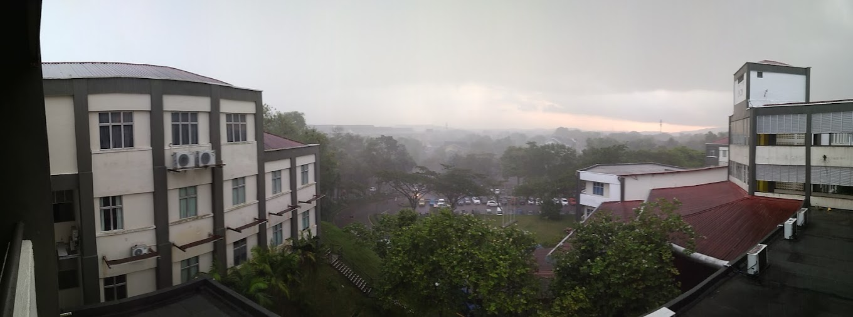





CORE VALUES
+
+
+
ISES
Integrity, Synergy
Excellence, Sustainability
PURPOSE
Employees and students can meaningfully connect to their work, their team, and their institution’s purpose (i.e. sense of purpose)
PERSEVERANCE
Employees and students who persisted in trying despite obstacles, setbacks, or opposition.
PROBLEM SOLVER
Employees and students have the capacity to recognize issues, generate and evaluate solutions, and apply the most effective ones.

Slide 9
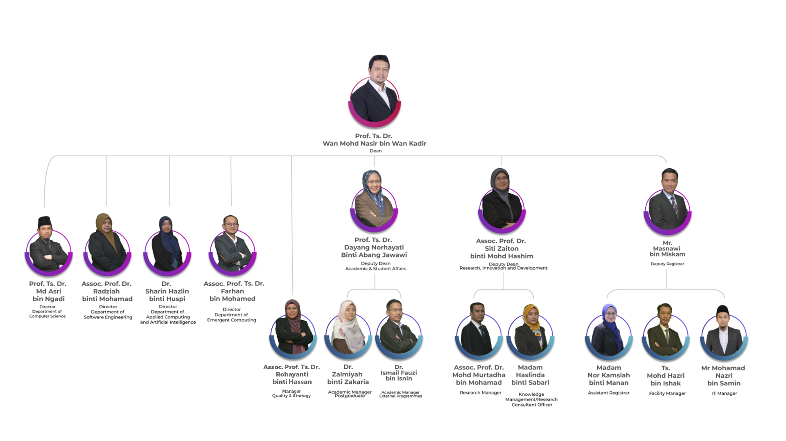


ORGANISATION CHART
www.utm.my

Slide 10





STAFF
102
46
Academic Staff
Supporting Staff
10 - Professor
19 - Associate Professor
68 - Senior Lecturer
05 - Lecturer
29 - Administrative
17 - Technical
Computer Science
26
22
Emergent Computing
03 - Professor
05 - Assoc. Professor
15 - Senior Lecturer
03 - Lecturer
02 - Professor
03 - Assoc. Professor
16 - Senior Lecturer
01 - Lecturer
Software Engineering
Applied Computing &
Artificial Intelligence
03 - Professor
07 - Assoc. Professor
15 - Senior Lecturer
01 - Lecturer
26
28
02 - Professor
04 - Assoc. Professor
22 - Senior Lecturer
00 - Lecturer
7

Slide 11
ACADEMIC PROGRAMMES

Slide 12


ACADEMIC PROGRAMMES
MSc (Computer Science)
BCS (Graphics & Multimedia)
BCS (Software Engineering)
4.0
Master of Cyber Security
MSc (Data Science)
Master in Innovative Computing
BCS (Bioinformatics)
BCS (Comp Networks & Security)
4.0
MPhil (Software Engineering)
MPhil (Computer Science)
PhD (Computer Science)
BCS (Data Engineering)
PhD (Software Engineering)
PhD (Informatics Engineering)
4.0
UNDERGRADUATE (UG) Programme
POSTGRADUATE (PG)
Programme

Slide 13









STUDENT ENROLMEN
1661
UNDERGRADUATE STUDENTS
BACHELOR OF COMPUTER SCIENCE (BIOINFORMATICS)
WITH HONOURS
SCIENCE (SOFTWARE ENGINEERING) WITH HONOURS
BACHELOR OF COMPUTER SCIENCE (DATA ENGINEERING) WITH HONOURS
BACHELOR OF COMPUTER SCIENCE (COMPUTER NETWORKS & SECURITY) WITH HONOURS
BACHELOR OF COMPUTER SCIENCE (GRAPHICS AND MULTIMEDIA SOFTWARE) WITH HONOURS
151
663
195
401
251
571
POST GRADUATE STUDENTS
MASTER OF COMPUTER
SCIENCE
28
MASTER OF SIBER SECURITY
43
DOCTOR OF PHILOSOPHY FIELD: INFORMATION SYSTEM
14
DOCTOR OF PHILOSOPHY FIELD:INFORMATICS ENGINEERING
14
ODL
24
MASTER IN INNOVATIVE COMPUTING
5
MASTER OF SCIENCE (DATA SCIENCE)
58
MASTER OF PHILOSOPHY FIELD: SOFTWARE ENGINEERING
7
MASTER OF PHILOSOPHY FIELD: COMPUTER SCIENCE
31
DOCTOR OF PHILOSOPHY FIELD:COMPUTER SCIENCE
292
DOCTOR OF PHILOSOPHY FIELD: SOFTWARE ENGINEERING
9
ODL
46
9

Slide 14
GRADUATE EMPLOYABILITY
GE
Employed
Further Studies
Waiting for Posting
Upskilling/Reskilling Training
Premium Employment
39.9%
PERCENTAGE (%)
Local Graduate GE
100%
Local Graduate PE
36.3%
YEAR

Slide 15
RESEARCH, DEVELOPMENT,
COMMERCIALIZATION & INNOVATION

Slide 16
RESEARCH GROUPS & CENTRE OF EXCELLENCE
Information Assurance and Security (IASRG)
Pervasive Computing Research Group (PCRG)
6
Software Engineering Research Group (SERG)
RESEARCH GROUPS
Intelligent Informatic Research Group (IIRG)
2
Virtual, Vision & Visualization Research Lab (VicubeLab)
CENTRES OF
EXCELLENCE
Applied Industrial Analytics (ALIAS)
Media and Game Innovation Centre of Excellence (MaGICX)
UTM Big Data Centre (BDC)

Slide 17


RESEARCH GRANT, PI & PUBLICATION
ACHIEVEMENTS
RESEARCH GRANT, PI & PUBLICATION ACHIEVEMENTS
06
01
VICUBELAB
ALIAS
52.6% PI
RM 442,124 with 6 projects secured
49 Indexed Publication
19 Copyright, 1 Patent
RG Leader
Dr. Ajune Wanis binti Ismail
19 members
RG Leader
Dr. Mohamad Shukor bin Talib
12 members
58.3% PI
RM 68,068 with 1 projects secured
21 indexed publications
KTP: 2 Project (CE)
2 Copyright
05
02
SERG
Faculty of Computing
IIRG
Percentage (%)
RG Leader
Assoc. Prof Dr. Rohayanti binti Hassan
19 members
RG Leader
Assoc. Prof. Dr. Mohd Shahizan
bin Othman
28 members
52.6% PI
RM 844,089 with 10 projects secured
31 indexed publications
KTP: 1 (1 Star Rating
2 Copyright
57.1% PI
RM 222,757.49 with 5 projects secured
16 indexed publications
KTP: 7 (2 Star Rating)
13 Copyright
Premium Employment
206 (27.58%)
04
03
PCRG
IASRG
30% PI
RM 312,601 with 4 projects secured
16 indexed publication
KTP: 1 (1 Star Rating)
3 Copyright
RG Leader
Ts. Dr. Haliza binti Wahab
10 members
RG Leader
Ts. Dr. Siti Hajar binti Othman
14 members
28.6% PI
RM 128,279.60 with 1 projects secured
25 indexed publications
1 Copyright

Slide 18

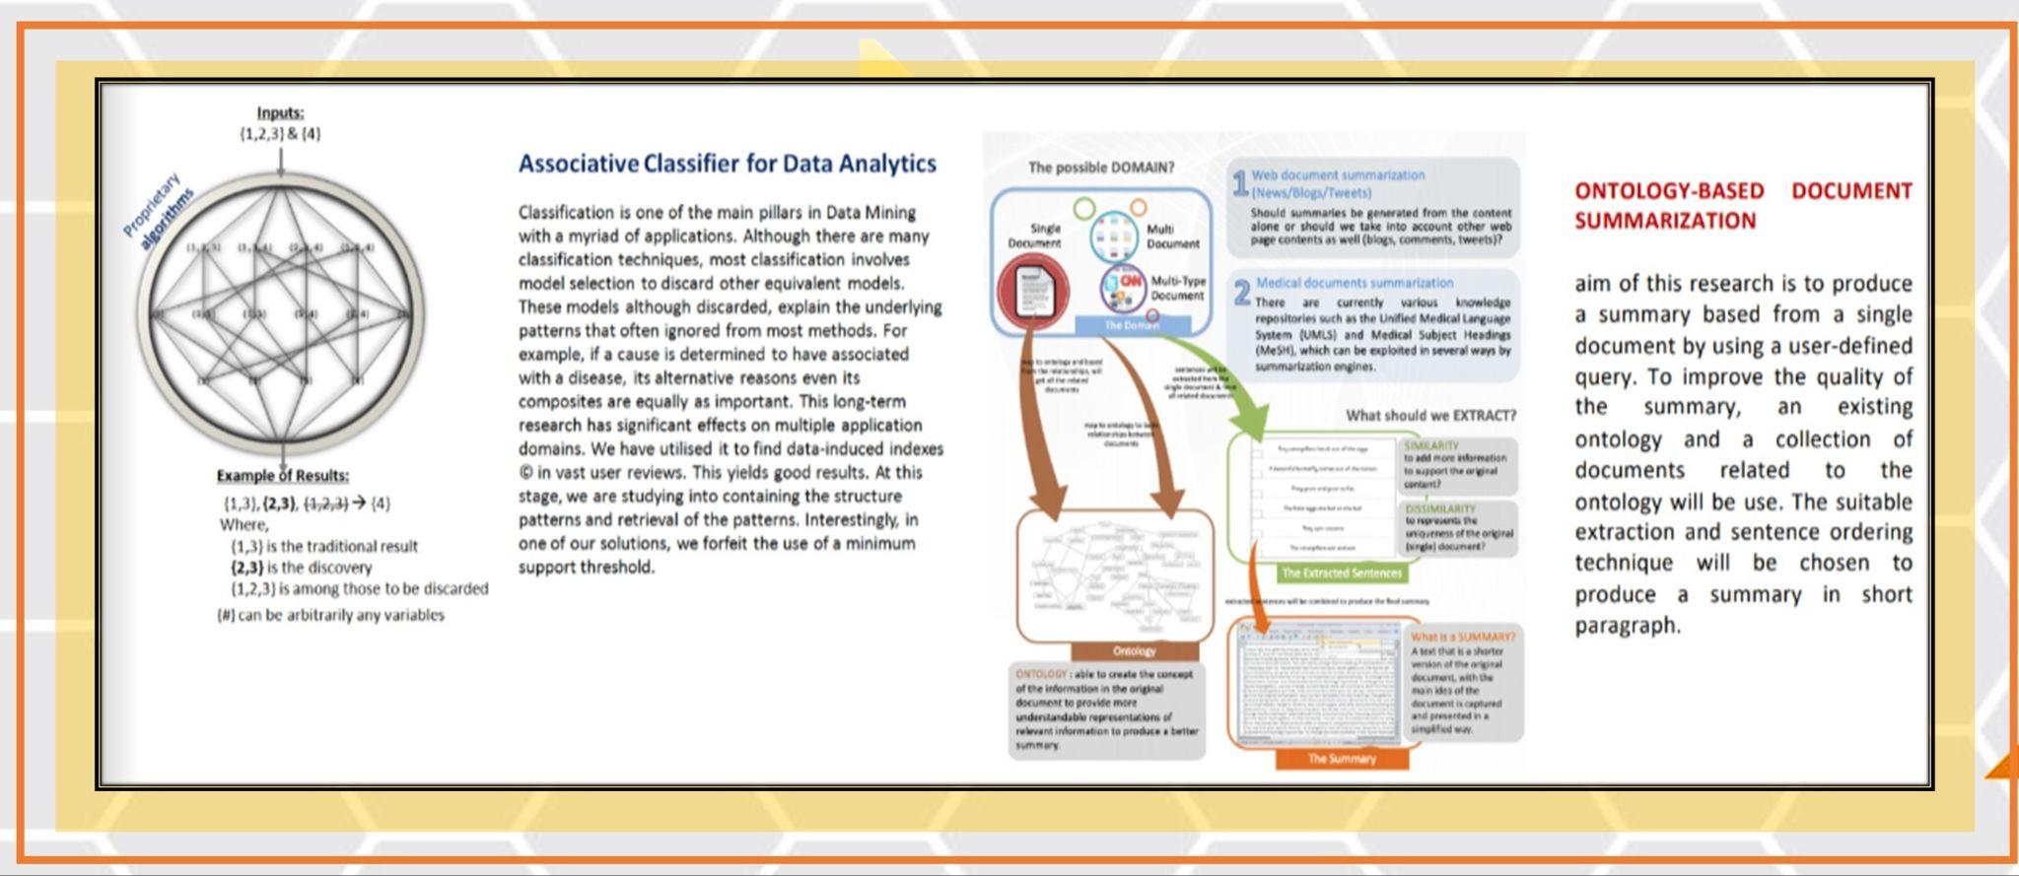
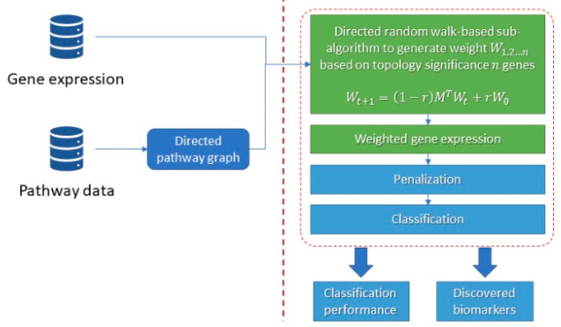
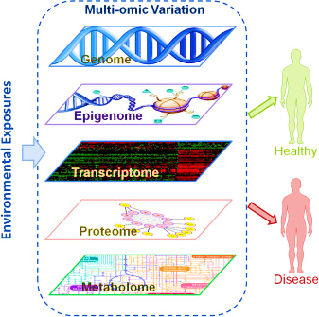


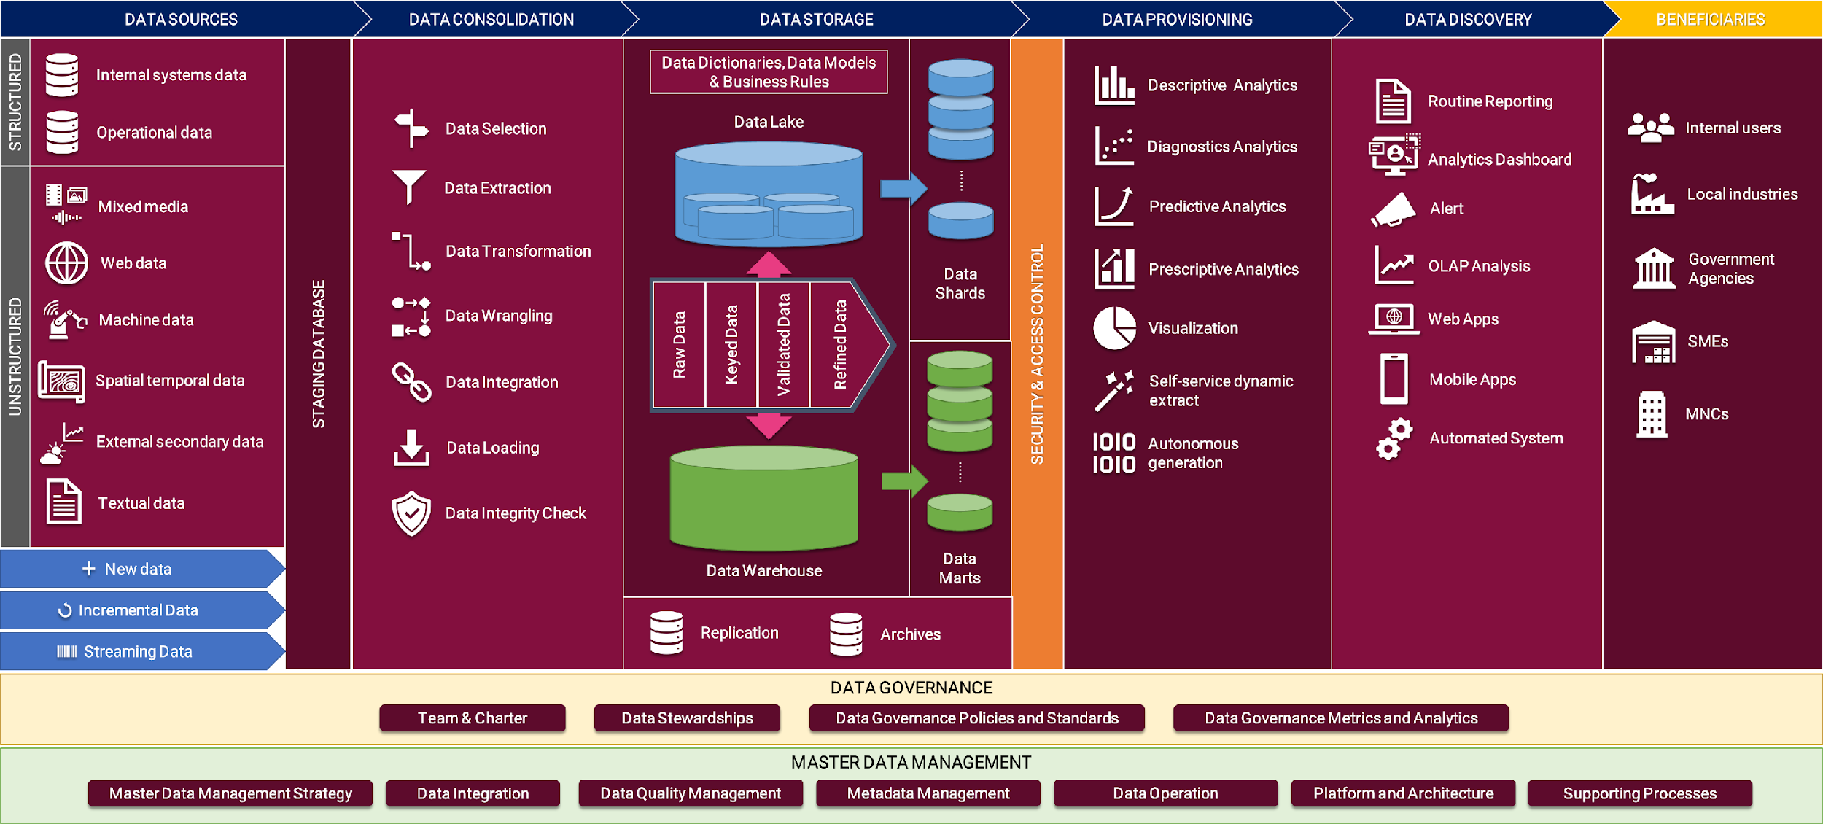
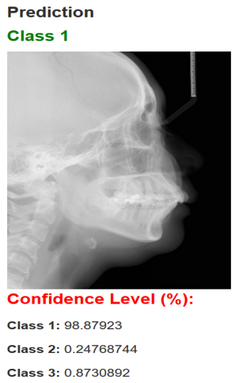
Informatic Intelligent Research Group (IIRG)
Intelligent informatics is an interdisciplinary field that combines principles and methods from computer science, artificial intelligence, statistics, and other related fields to create intelligent systems or solutions which employ advanced algorithms and models to process, analyze, and interpret large amounts of data. Key research areas within intelligent informatics include Artificial Intelligence, machine learning, deep learning, cognitive computing, soft computing, security informatics, data science, computer vision, pattern recognition, bioinformatics, intelligent software engineering, intelligent networked systems, NLP, Social Informatics & Design Science. The aim of this field is to develop model-solutions that can learn, reason, and interact with the environment in a way that emulates human intelligence.
Associative Classifier for Data Analytics
Identification of Multi-Omics Features for Cancer Classification using Improved Stacked Denoising Autoencoders (Collaborator : IMR)
Deep Learning-Based Decision Support System For Diagnosis Of Malocclusion Using Lateral Cephalograms Image
(Collaborator : USIM & UiTM)
Data Lake-house Design and Development
(Prof. Dr. Naomie Salim and Team Members)
PreBioMarkers
Discovery Using
Improved Penalized Machine Learning Algorithm
(Collaborator : FBME)
17

Slide 19

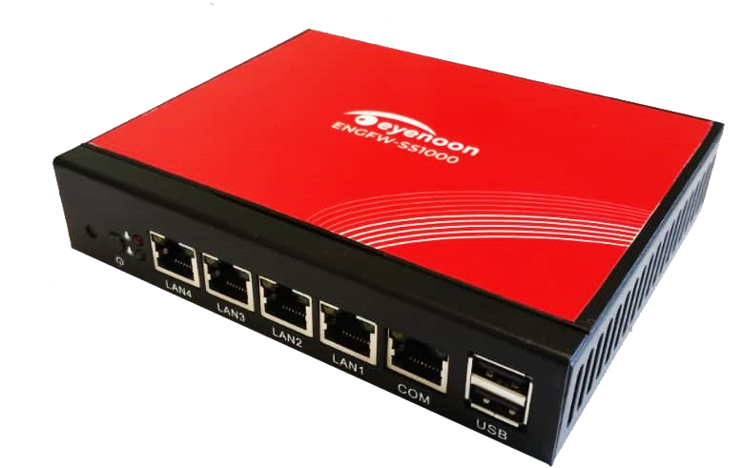

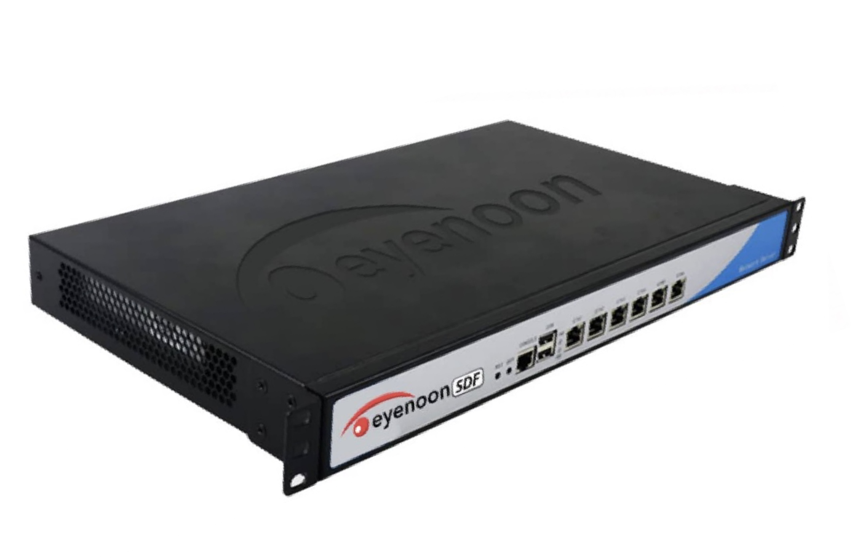

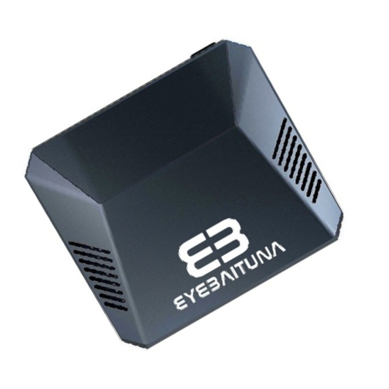

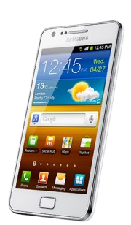

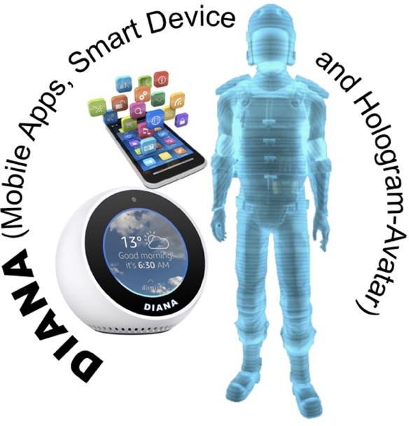
Information Assurance & Security Research Group
(IASRG)
Niche Area
Web Filtering, Cyber Threat Analytic, Intrusion Detection/Prevention Systems, Malware Detection, Digital Forensic, Cryptography, Watermarking & Information Hiding, IoT and Wireless Sensor Security, Information Security & Management, Information Disaster & Risk Management.
FRAUD AND FAKE NEWS
Detection
Fake News Detection in Social Media
Fraudulent Commercial Website Detection
Adaptive Anomaly Based Telecommunication Fraud Detection for Handling Concept Drift
FRAUD AND FAKE NEWS
Detection
RESEARCH
Context-Aware Data-Centric Misbehavior Detection Approach for V2V Communication
On-board Self Misbehavior Detection for Vehicular Network
Misbehavior-Aware On-Demand Collaborative Intrusion Detection
Data-Driven Modelling for RANSOMWARE
Early Detection
Ransomware Attacks Behavioral Analysis during the Pre-encryption Phases Using Information Theory
Ransomware Zero-Day Attacks Detection Using Ensemble Learning
Misbehavior Detection for VEHICULAR NETWORKS
RE S E ARC H P RO D U C T
SECURITY MANAGEMENT
& BLOCKCHAIN
Metamodel and Ontology of Disaster and Cybersecurity Risk
Blockchain Techology in Cybersecurity
Conceptual Modelling of Security Risk Management
Threat Driven Cybersecurity Audit Model Using Metamodel Approach
NE X T G E NE RAT I O N F I RE W AL L
Internet Filtering and Monitoring System
DATA PRIVACY
&
Data Mining
Privacy Preserving Association Rule Mining Using Attribute-Identity Mapping on Real Sensitive Data
Comprehensive Privacy Preserving Data Mining Model in Digital Campus
DATA PRIVACY
&
Data Mining
Digital Forensic Metamodel
JPEG Image Forensic
DIGITAL FORENSIC
Social Network Forensic and Trust Model
HOME-BASED
Home and SOHO
SMALL MIDSIZE ENTERPRISE
IDS
& CYBER
THREAT INTELLIGENCE
Intrusion Detection System for Large Scale Attack in Software Defined Network
Adaptive IDS for Dynamic Network Traffic Using Machine Learning
An Adaptive and Distributed Cloud Intrusion Detection Scheme
Detection of Tax Gap Using Machine Learning
Ontology-based Ransomware Entity Classification From Forum to Form Background Knowledge
Detecting Cyber Attack Incidents from Online News Using CRF and LSA Techniques
Security & Social Threat Assistant
DI GI T A L CI T I Z E N SH I P A SSI ST AN T
Our Research and Products Utilizing State-of-the-Art Technologies >>> IoT : AI : SECURITY : BIG DATA : DATA ANALYTICS : CLOUD DATABASE
18

Slide 20



Pervasive Computing Research Group (PCRG)
Niche Area
Internet of Things, Wireless Sensor Network, Wireless Mesh Network, Mobile Ad Hoc Network (MANET), Vehicular Ad Hoc Network (VANET), Wireless Body Area Network, Cloud Computing, Network Security, Blockchain.
Development of Mobile Application Human Capital Management System Authentication and Security Augmented Reality Artificial Intelligent Chatbot
.
Subject Matter Expert Internet of things (IoT)
Block Chain
System monitoring for Data Analytics CRG 19.3 Intelligent Report Based On Data Analytics for Asset Location.
Indoor Positioning Indoor Child Monitoring and Tracking Via augmented Reality (AR).Assisted by Internet of things (IoT)
Government Grant Reducing bandwidth Through New Mechanism Encode Transformation Filtering (ETF) for 360 degree Video for Online Education System.
Virtual Reality /Augmented Reality 360 Degree Video Bandwidth network reduction
.
20
19

Slide 21



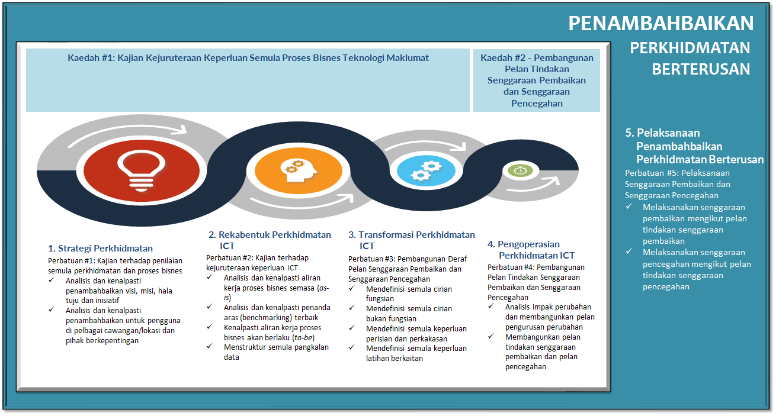







Software Engineering Research Group (SERG)
Niche Area
Software Modeling and Specification, Software Quality and Testing, Software Usability and Reusability, Software as Service, Dependable Embedded Real-Time Systems, Agile Software Development, Intelligent Software Systems, Model Driven Architecture, Software Product Line, Software Maintenance and Evolution.
Signature Projects
Business Process Improvements
SOFTWARE QUALITY ASSURANCE FOR KLANG VALLEY MASS RAPID TRANSIT (KVMRT) LINE 2 Client: Sapura EV Dynamic Consortium (SECO) SOFTWARE QUALITY ASSURANCE FOR Rapid Transit System (RTS) Link Client: Sapura Rail Systems Sdn Bhd and RTS Operations Pte Ltd THE DESIGN OF SERVICE-ORIENTED ARCHITECTURE FOR VARIOUS GOVERNMENT AGENCIES Client: GATES IT Sdn. Bhd. (i-WTP) Water Management System Industrial Collaborator: SAJ Sdn. Bhd. KEMPAS HOSPITAL MANAGEMENT SYSTEM Industrial Collaborator: Effron Sdn. Bhd.
A study of ICT Capacity Planning
A study of Business Process Improvement
A study of Business Process Improvement
20

Slide 22

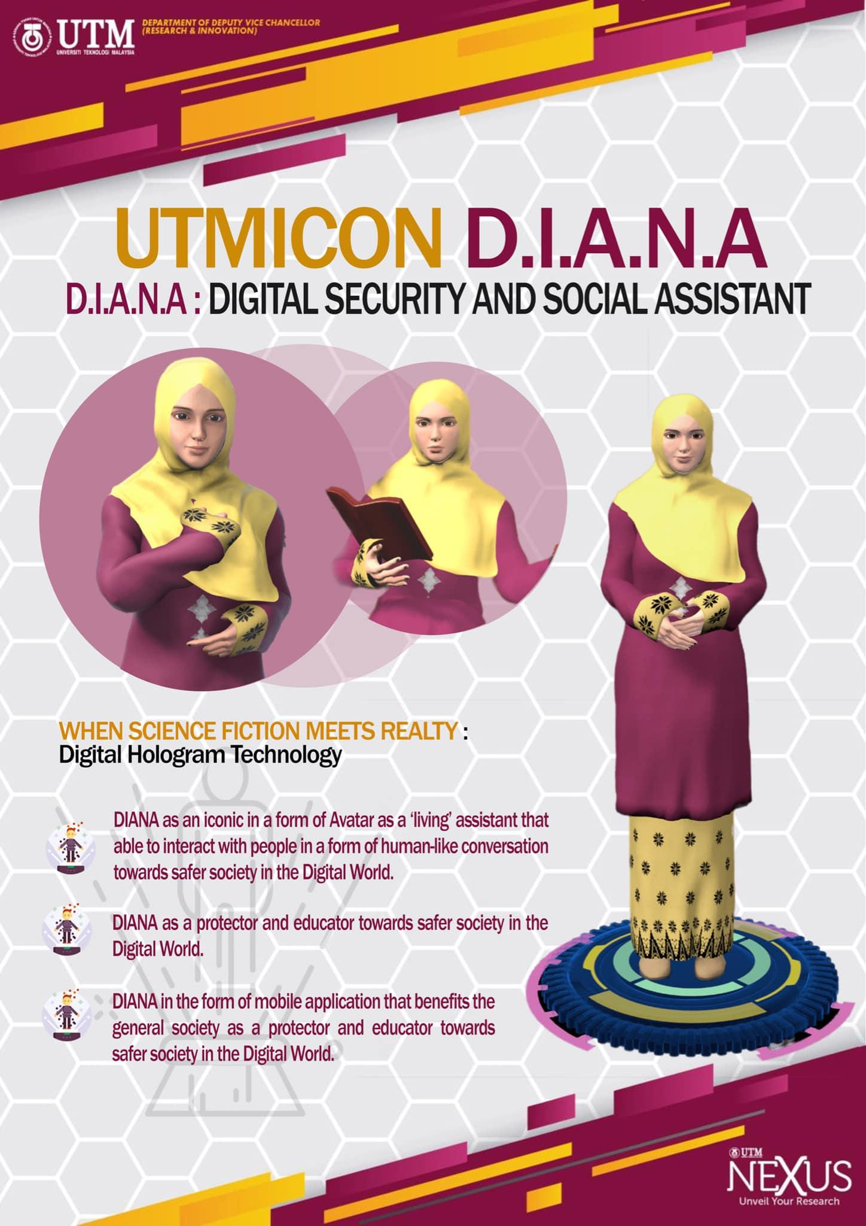
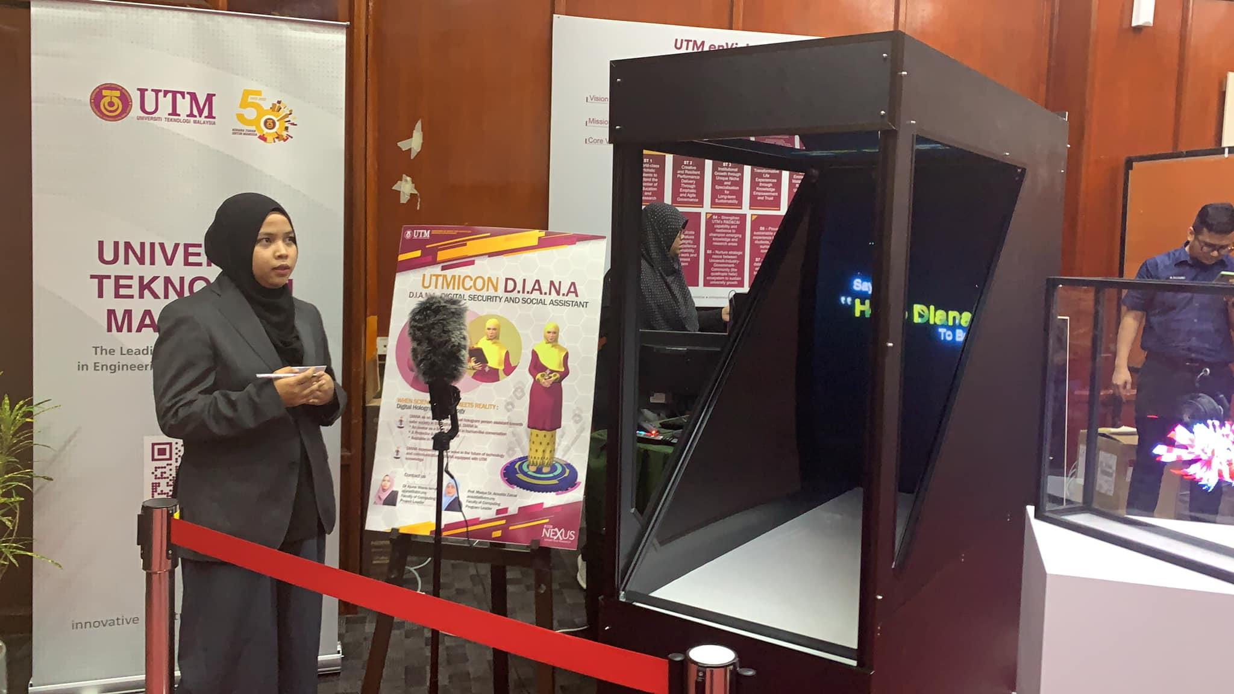
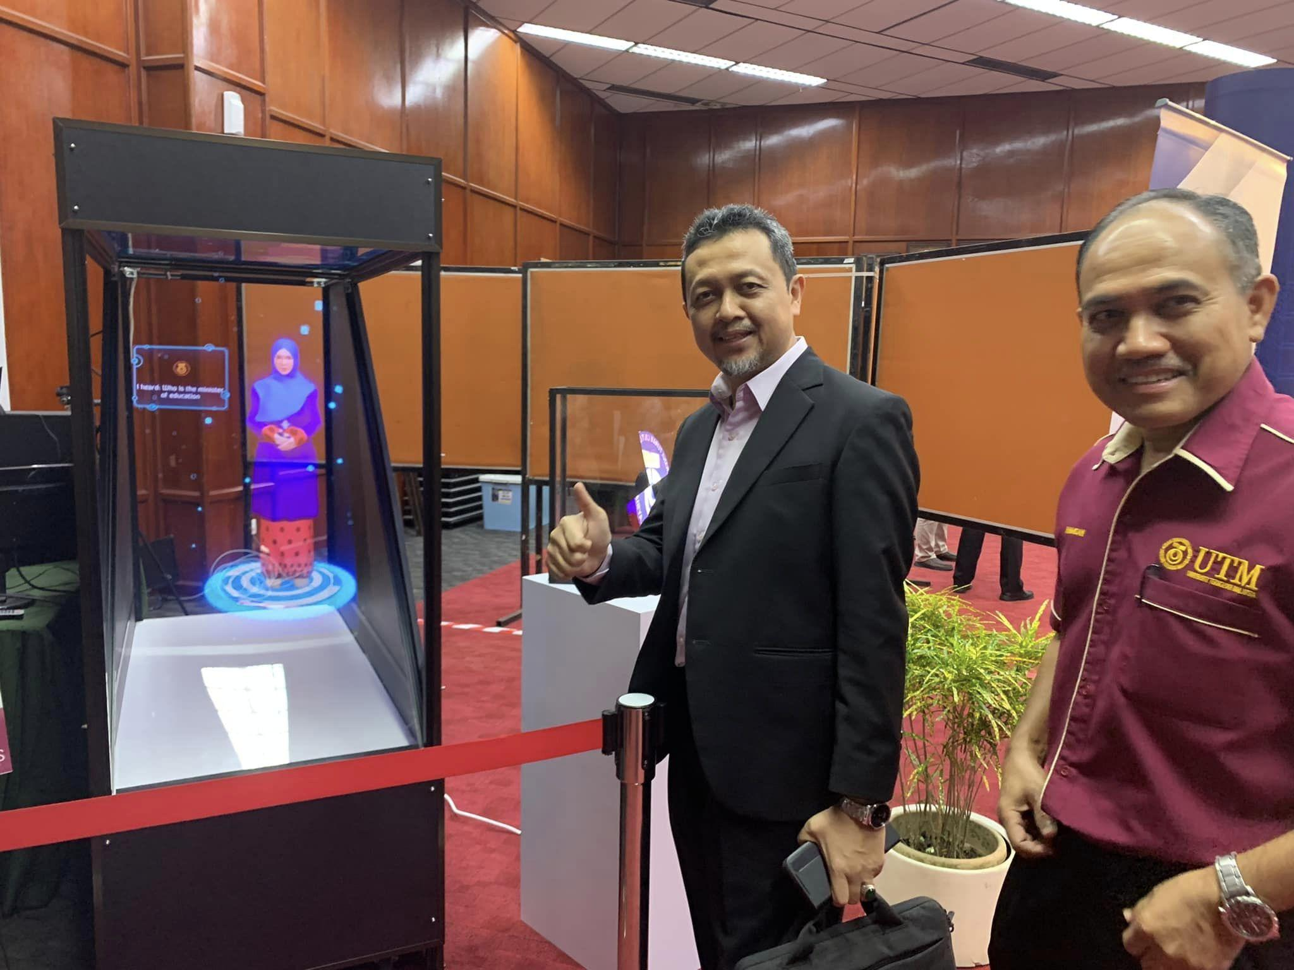
Virtual, Vision & Visualization Research Lab (VICUBELAB)
Niche Area
Computer Graphics and Visualization, Computer Vision, Image Processing, Speech Processing, Human Computer Interaction, Webometric, Intelligent System
D.I.A.N.A has the capability to strike conversations with users via spoken natural language, understands what users say, and responds in a meaningful way. This first version of D.I.A.N.A is trained with facts about UTM and was developed by Dr Ajune Wanis Ismail and her technical teams from Mixed and Virtual Environment Research Lab (Mivielab)focus on the front-end and core components to make D.I.A.N.A alive with artificial intelligence (AI), extended reality (XR) and natural language processing (NLP)
21

Slide 23
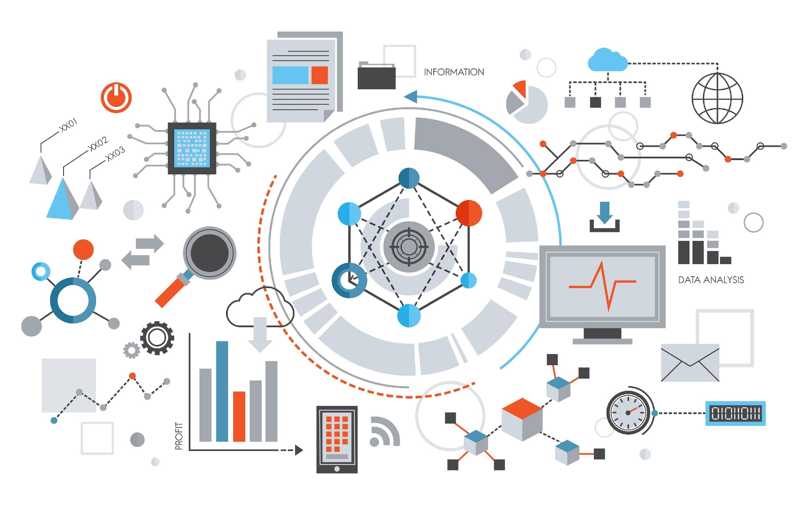
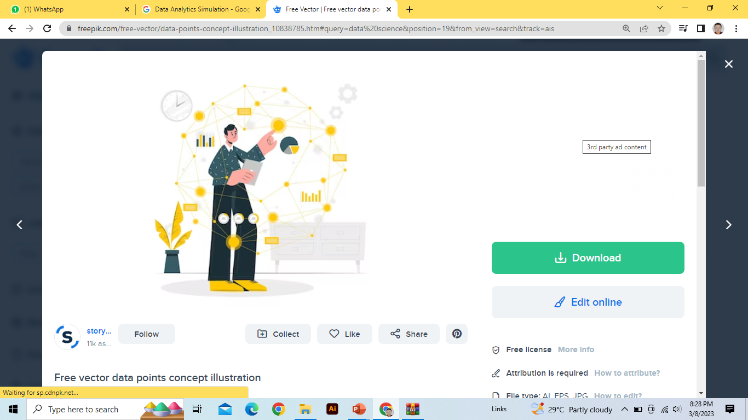
Applied Industrial Analytics (ALIAS)
Niche Area
Modeling, Optimization, Simulation, Industrial Analytics, AI - Soft computing
Research Group ALIAS Provide consultation on :
Modeling enhance decision ;-
Risk Analysis
Result Diagnostic
Evaluation of results .
Data Analytics Simulation
01
02
22

Slide 24
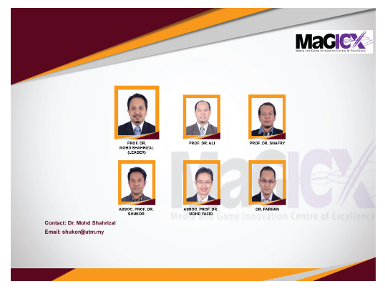
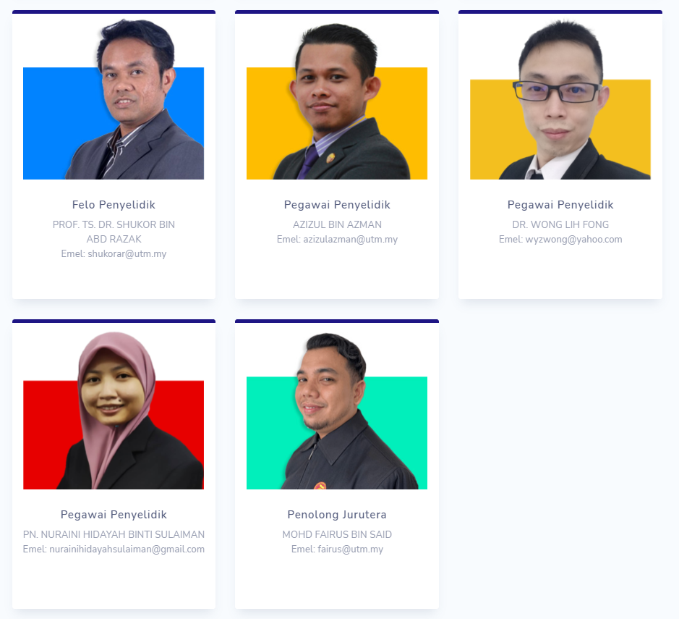
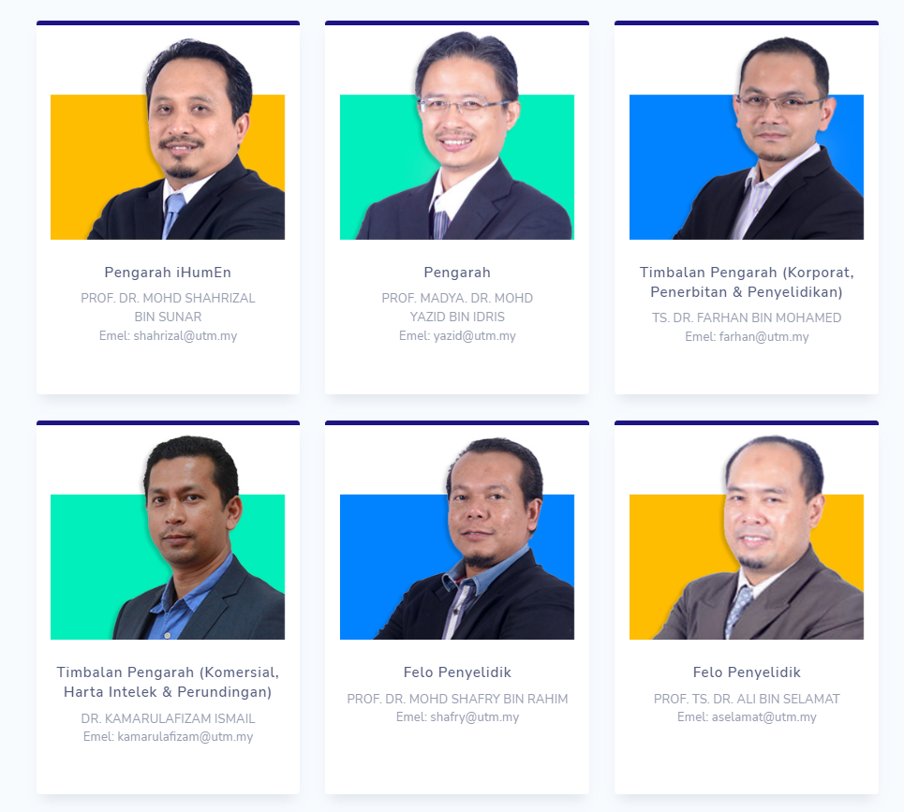
Media and Game Innovation Centre of Excellence (MaGIC-X)
Media and Game Innovation Centre of Excellence (MaGIC-X)
Media and Game Innovation Centre of Excellence (MaGICX) is a strategic cooperation between Universiti Teknologi Malaysia (UTM) and Iskandar Regional Development Authority (IRDA) to support and promote the development and ecosystem of creative industry that focuses on gamification and enrichment of digital content. MaGICX is a setup, tailor-made to offer industry players/SMEs/clients technical expertise/consultation,research/product development, business development, publishing, marketing and/or training in producing commercially viable Games and Gamification related products and services.
Niche Area
Augmented, Mixed and Virtual Reality, Image Processing and Computer Vision, Human Interface Technology, Medical Computing and Visualization, Digital and Social Media Security, Speech and Signal Processing, Multimedia and Software Innovation, Multimedia Software Engineering, Emerging Technology, Edutainment.
23

Slide 25
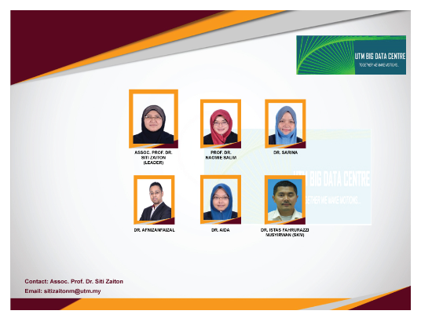
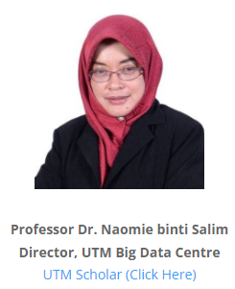
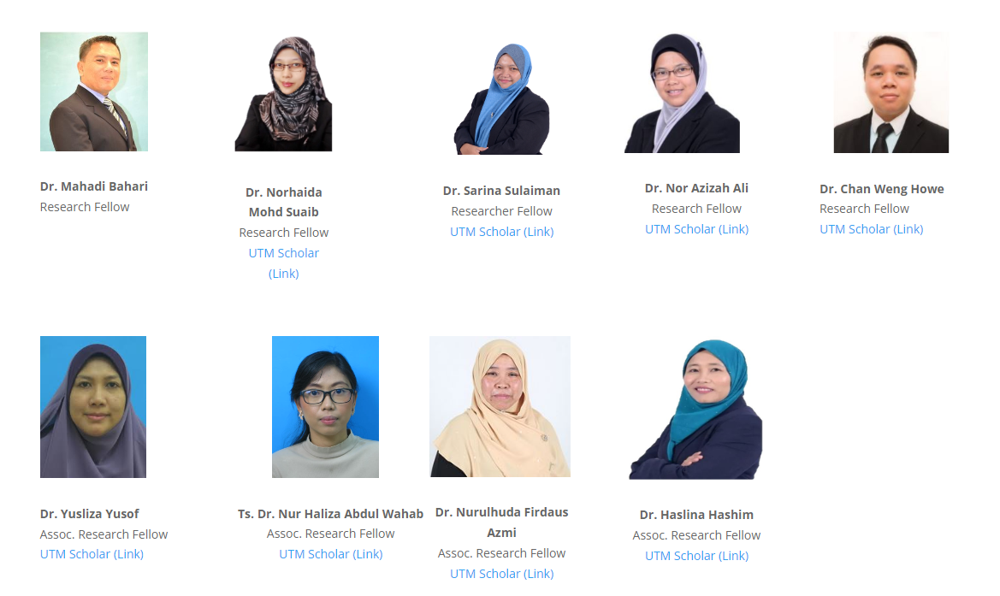
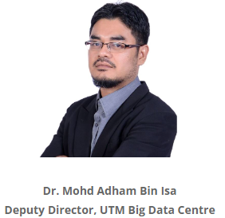
UTM Big Data Centre (BDC)
UTM Big Data Centre (UTM-BDC)
We are rooted from one of the active research groups in UTM: Soft Computing Research Group (SCRG). Since 2011, we have played the games in Data Science and Big Data until UTM Big Data Centre is officially established 15 April 2014. We have more than 20 years experiences in the field of Data Analytics, Machine Learning, Pattern Recognition, Computer Vision & Fundamental Aspect of Data Analytics. Now we blend our expertise in Big Data Analytics, CUDA programming, Graphics Processing Unit (GPU)-based Machine Learning and Big Data Platform in GPU environment.
Niche Area
Big Data Predictive Analytics, Deep Learning for Data Science, GPUMLib for Big Data Analytics, CUDA for Data Analytics, QR Big Data Codes for Security, Multimodal Biometric Analytics, Machine Learning, Soft Computing, Mobile GPU Computing.
24

Slide 26
ACHIEVEMENTS & HIGHLIGHTS

Slide 27
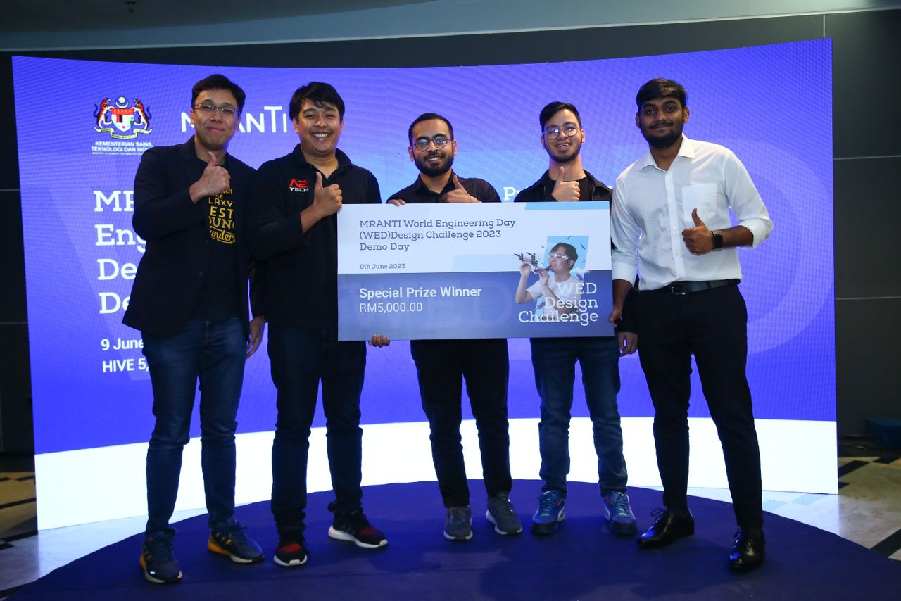
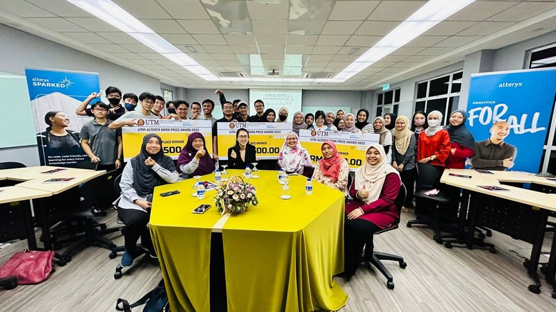
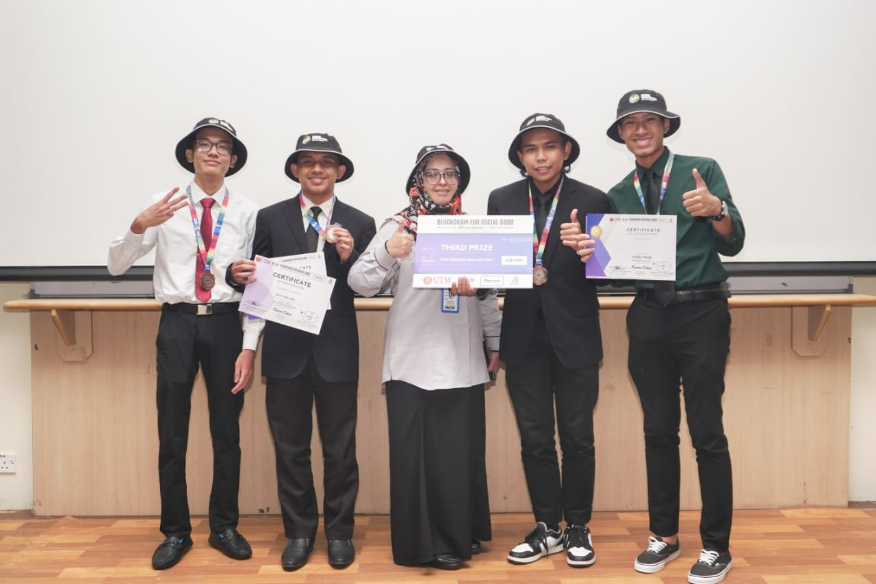
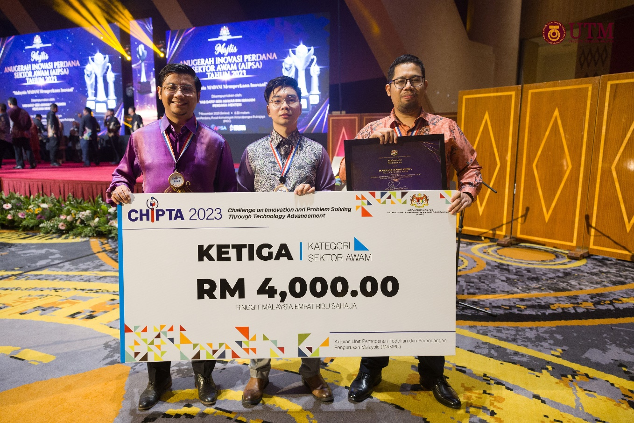
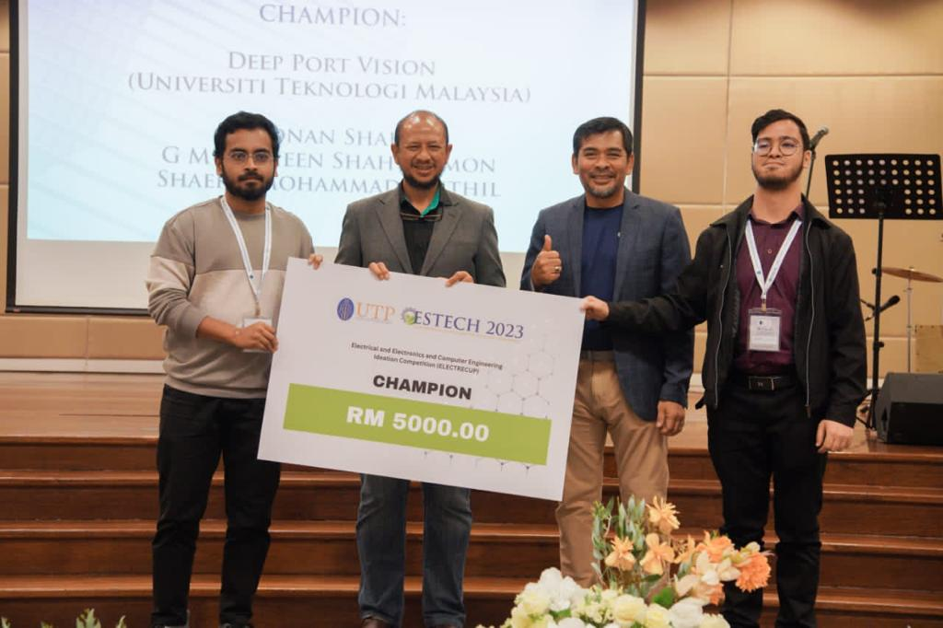
ACHIEVEMENTS 2023 HIGHLIGHTS

Slide 28
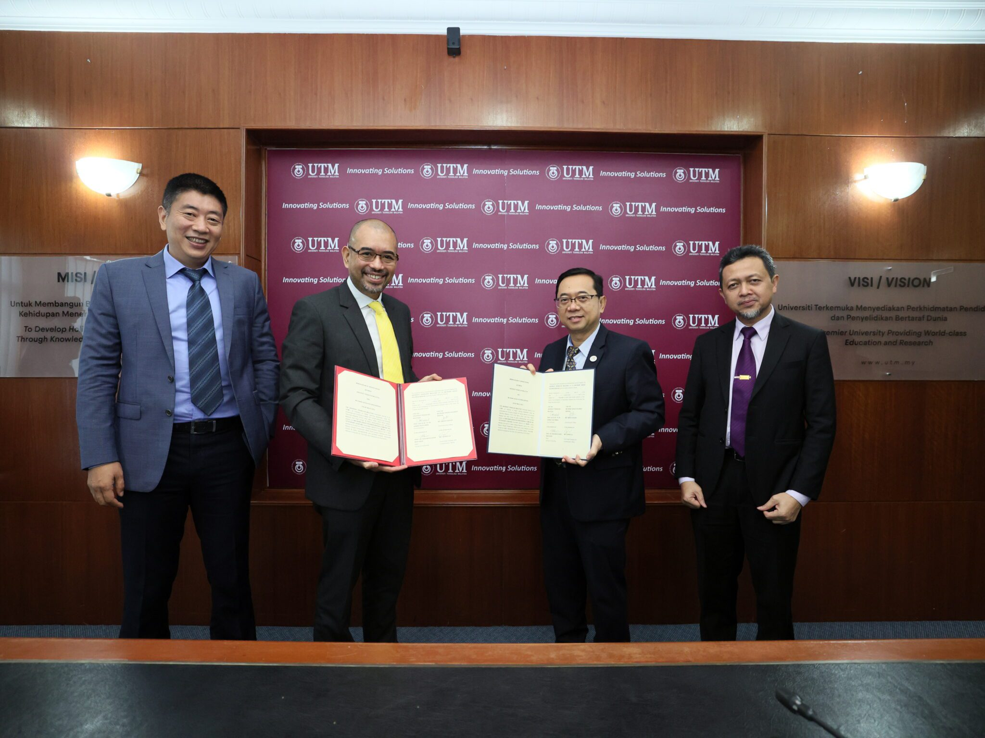
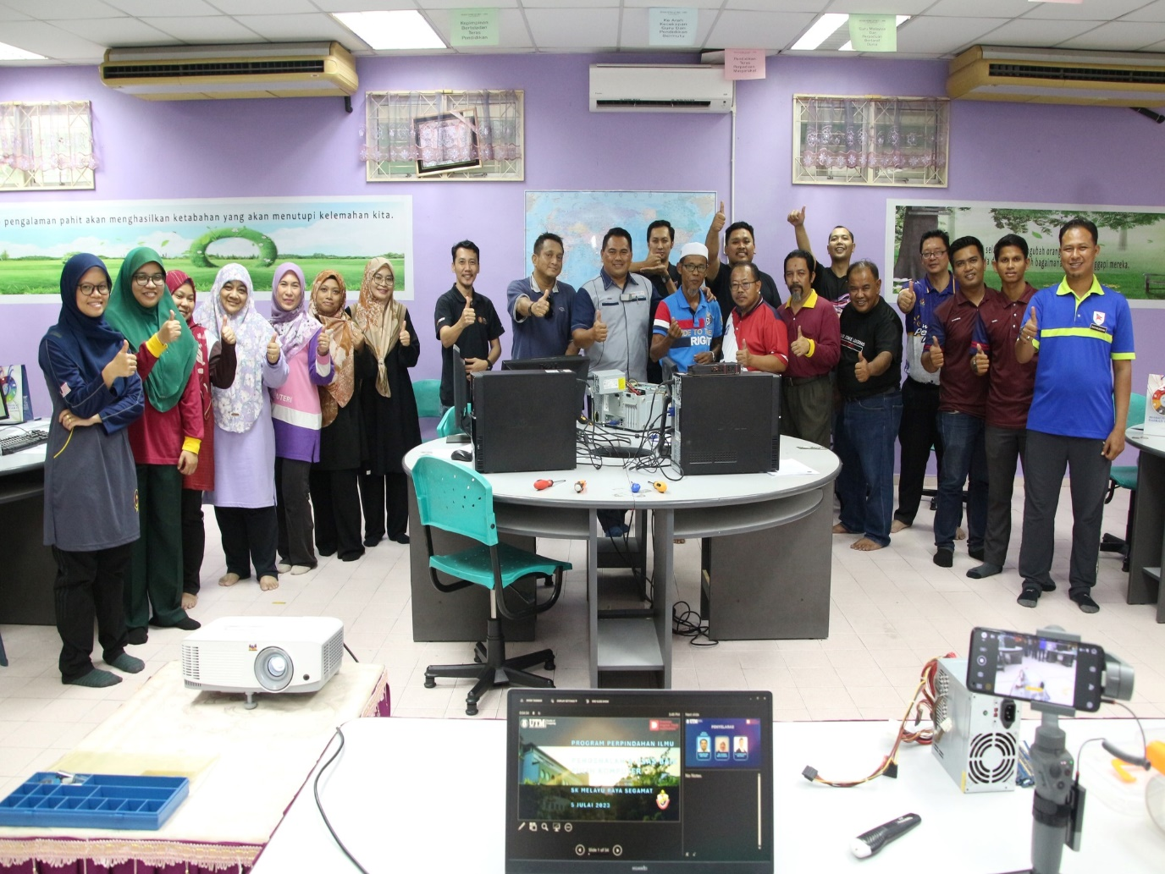
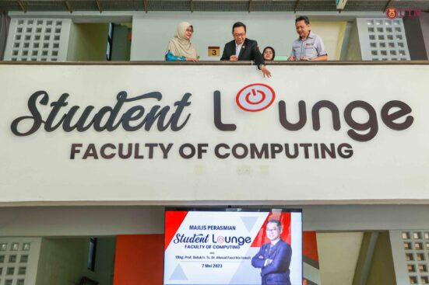
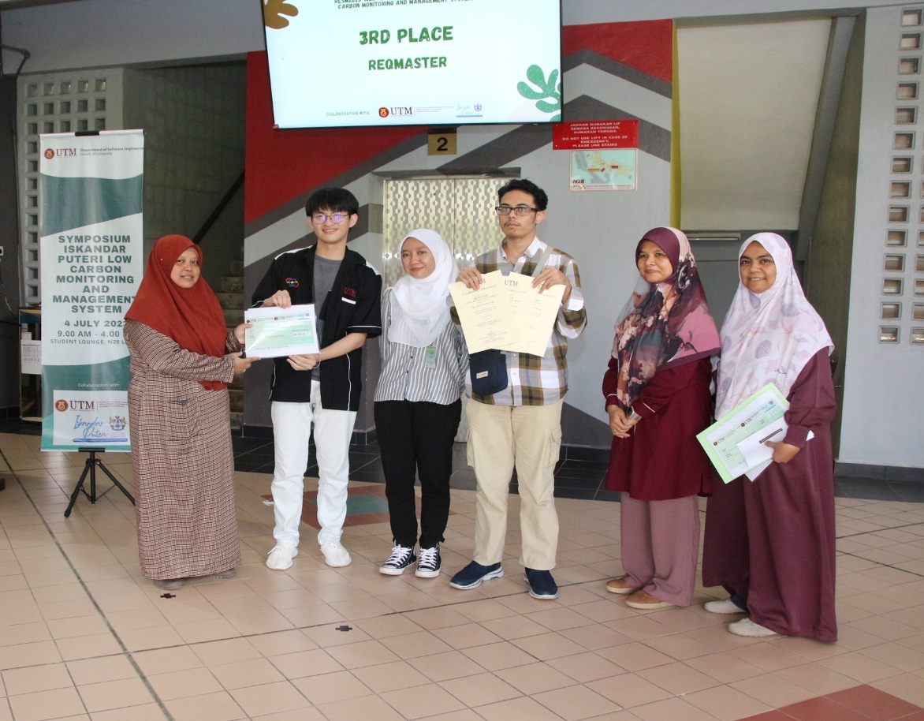
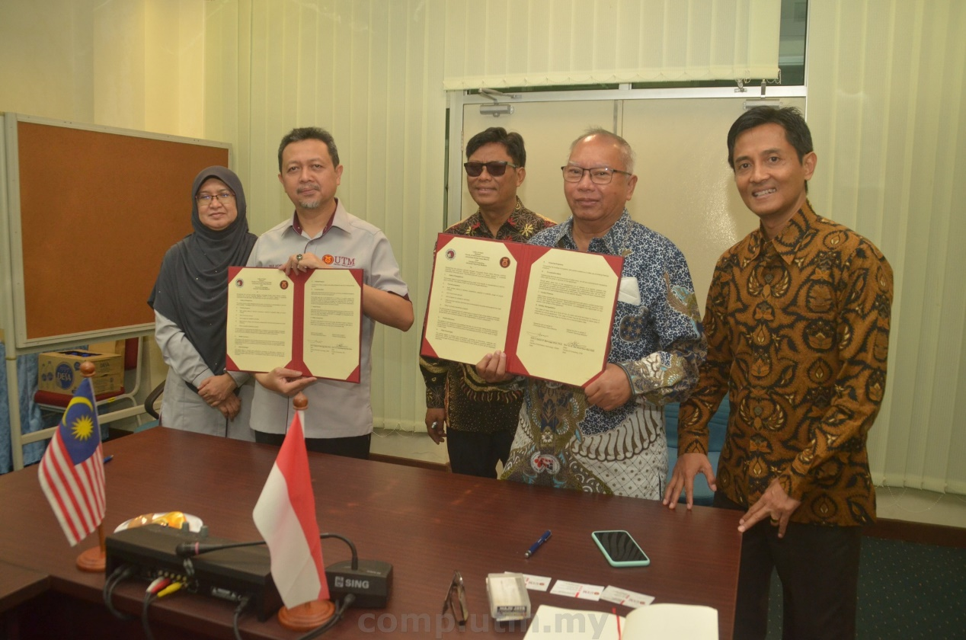
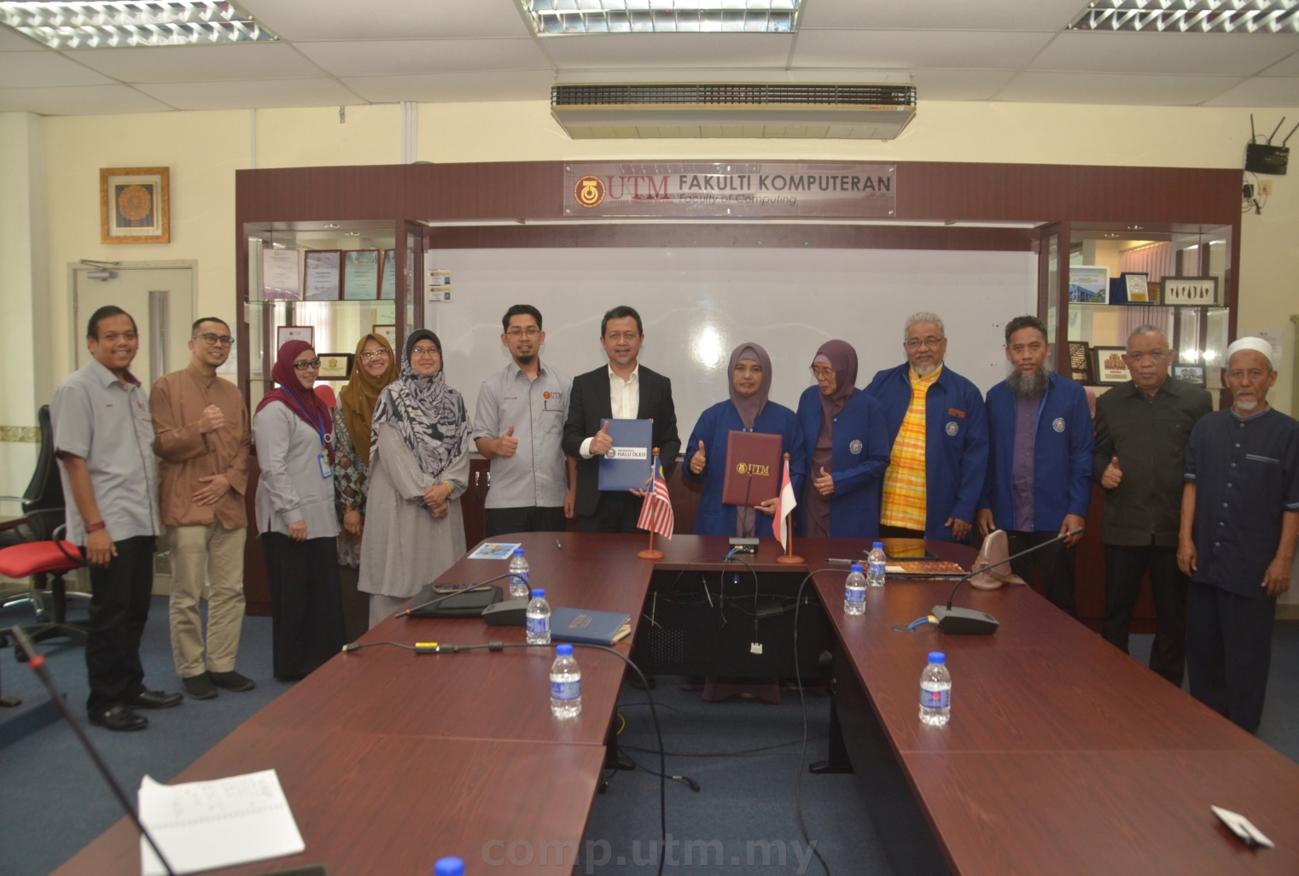
ACHIEVEMENTS 2023 HIGHLIGHTS

Slide 29
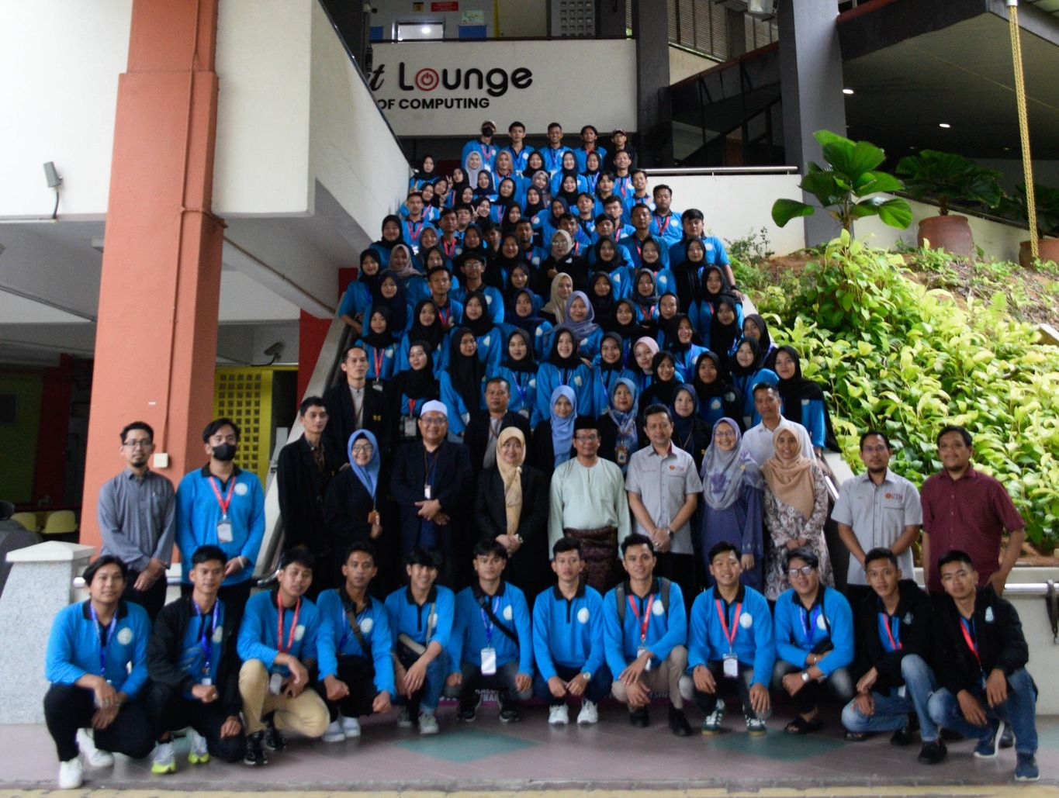
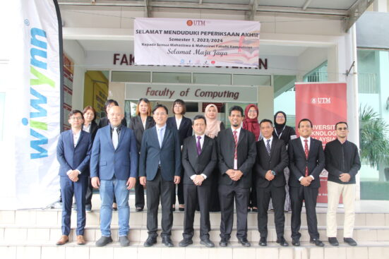
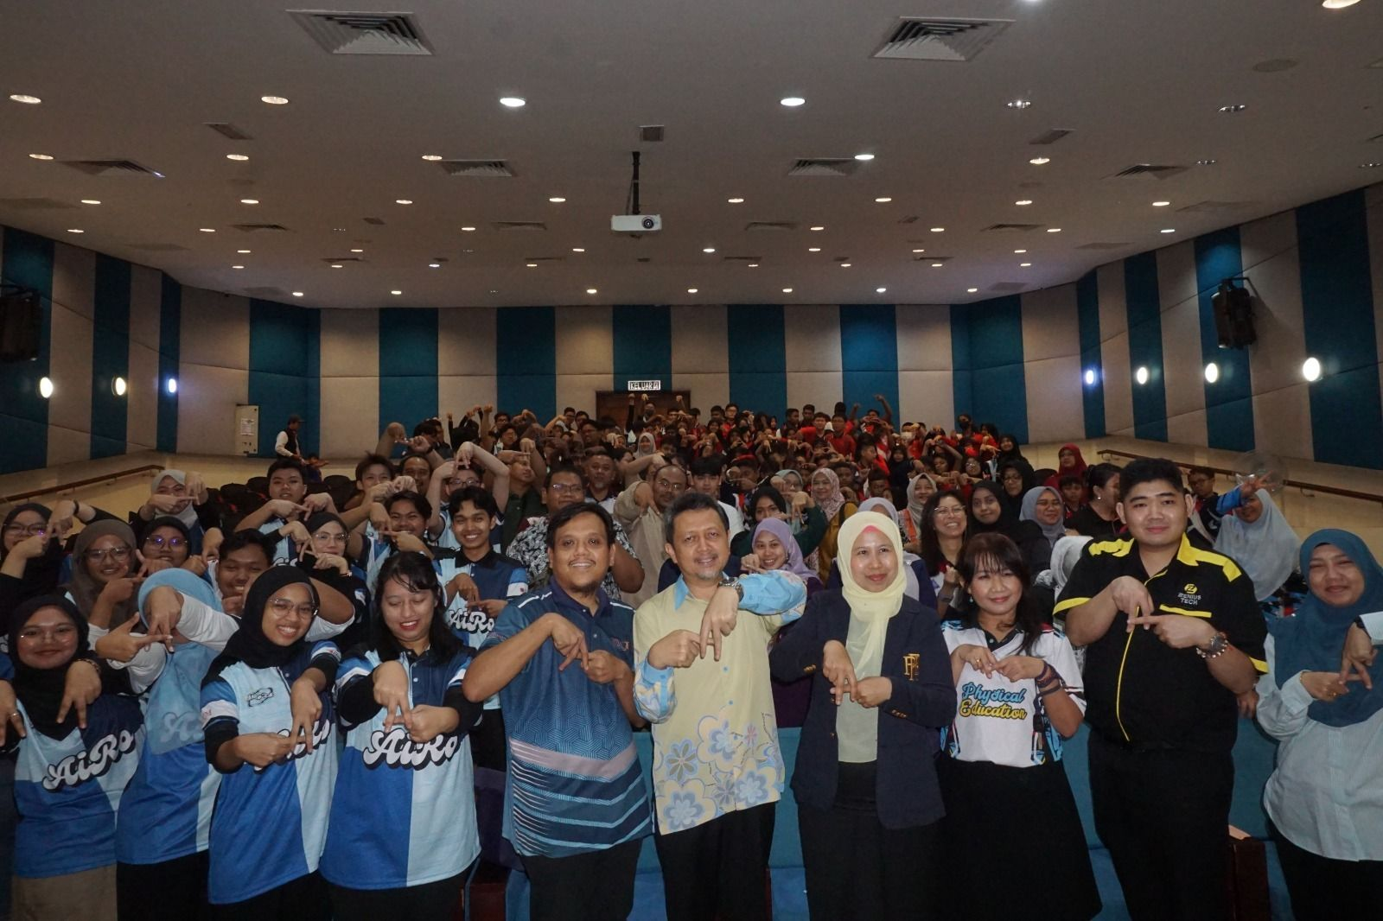
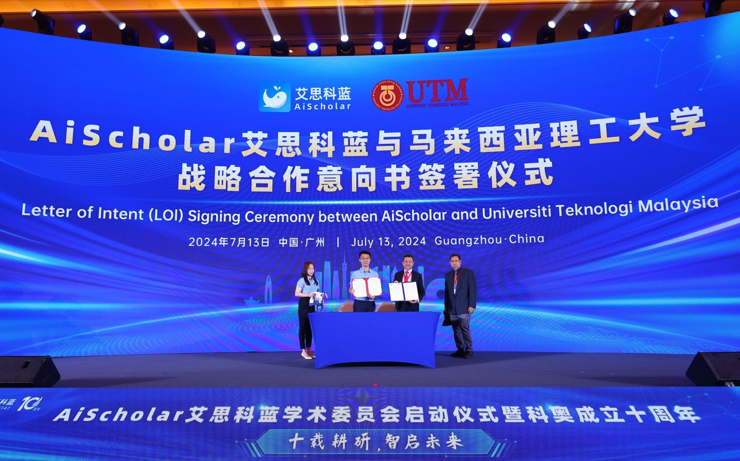
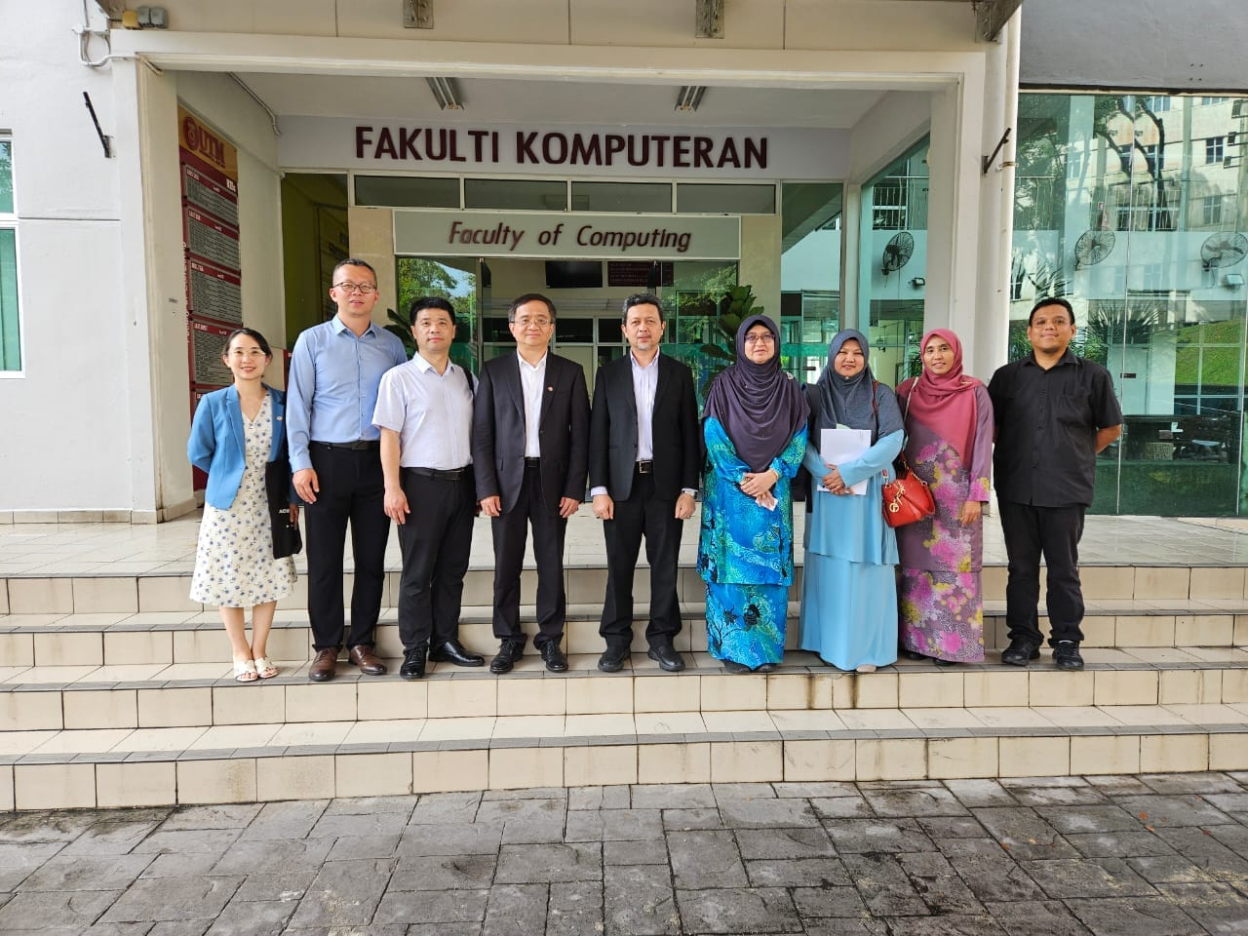
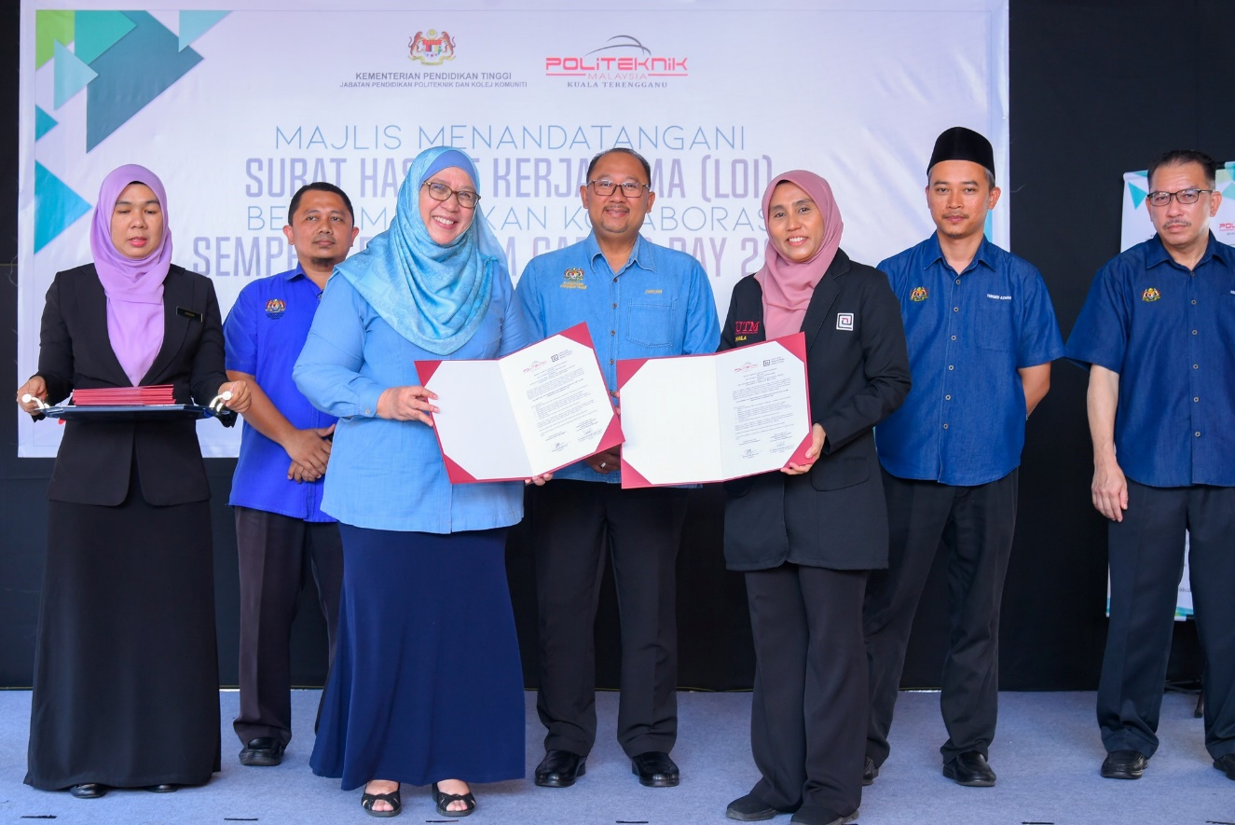
ACHIEVEMENTS 2024 HIGHLIGHTS
19

Slide 30

















MOU/MOA/LOC
2023
2022
2021

Slide 31





























INDUSTRY PARTNERS
…….. and many more
29

Slide 32


THANK YOU
utmofficial
univteknologimalaysia
utm.my

